Slide 1
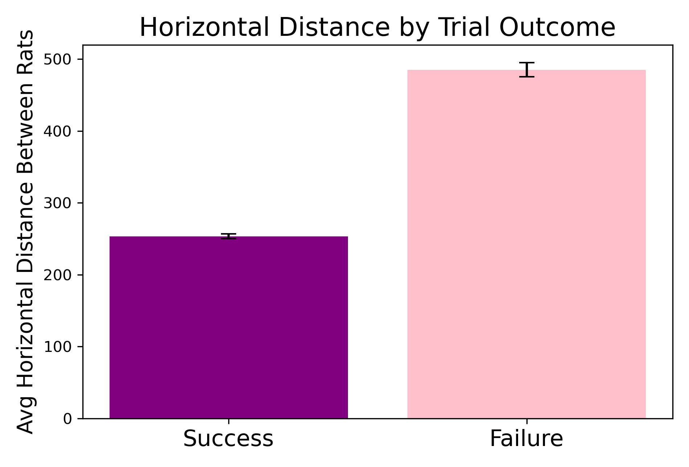
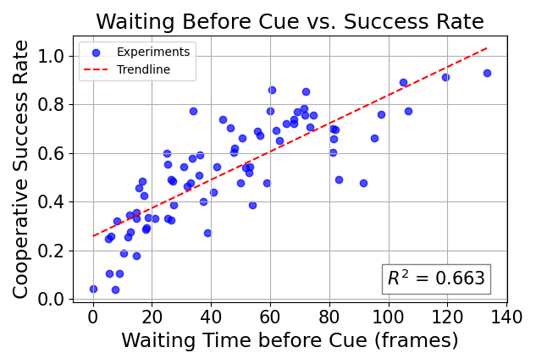
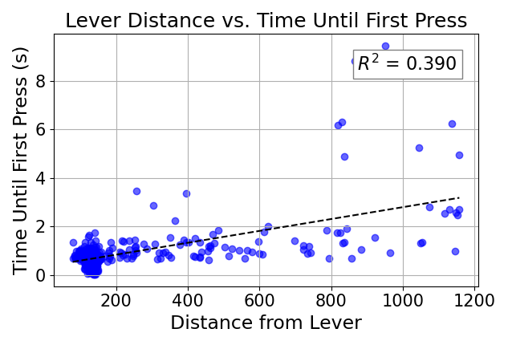
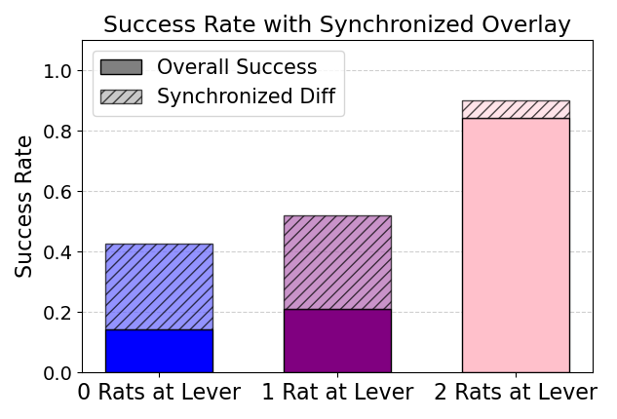
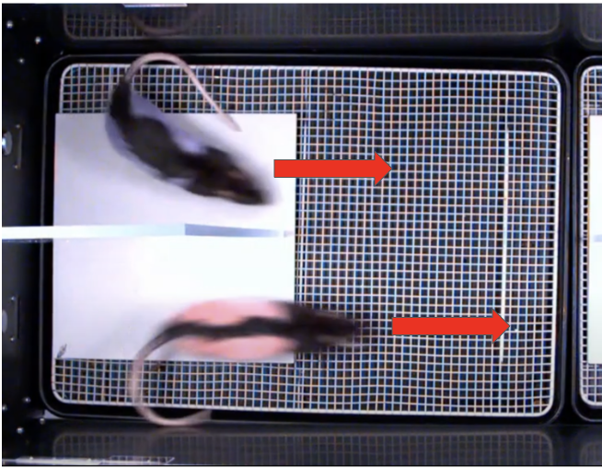
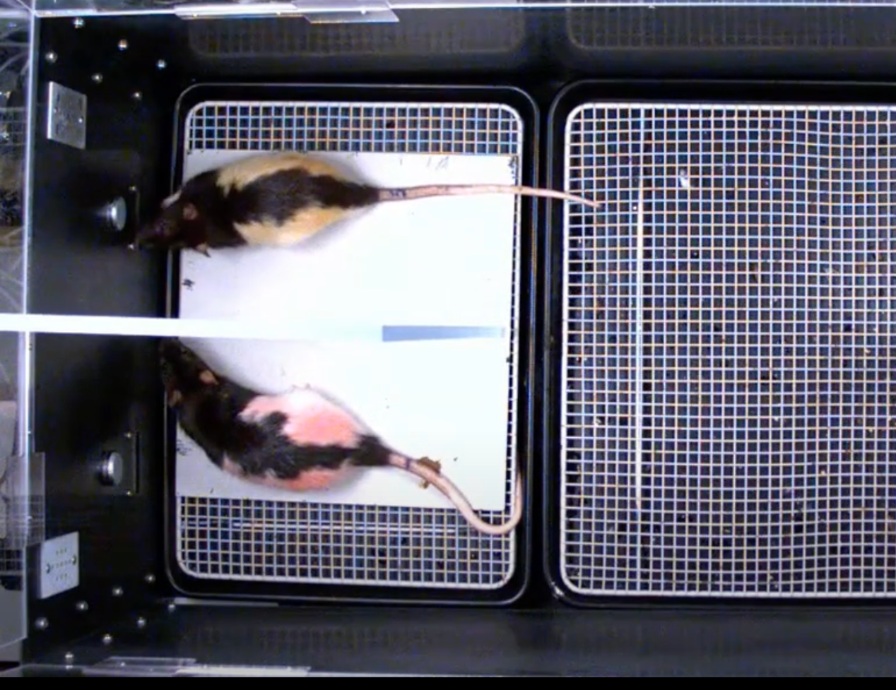
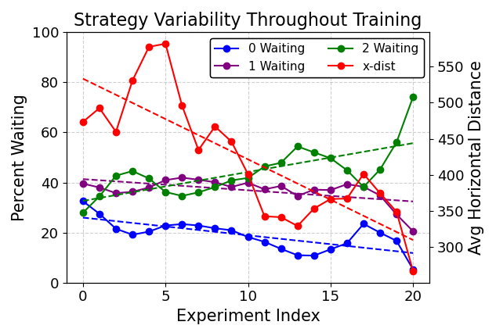
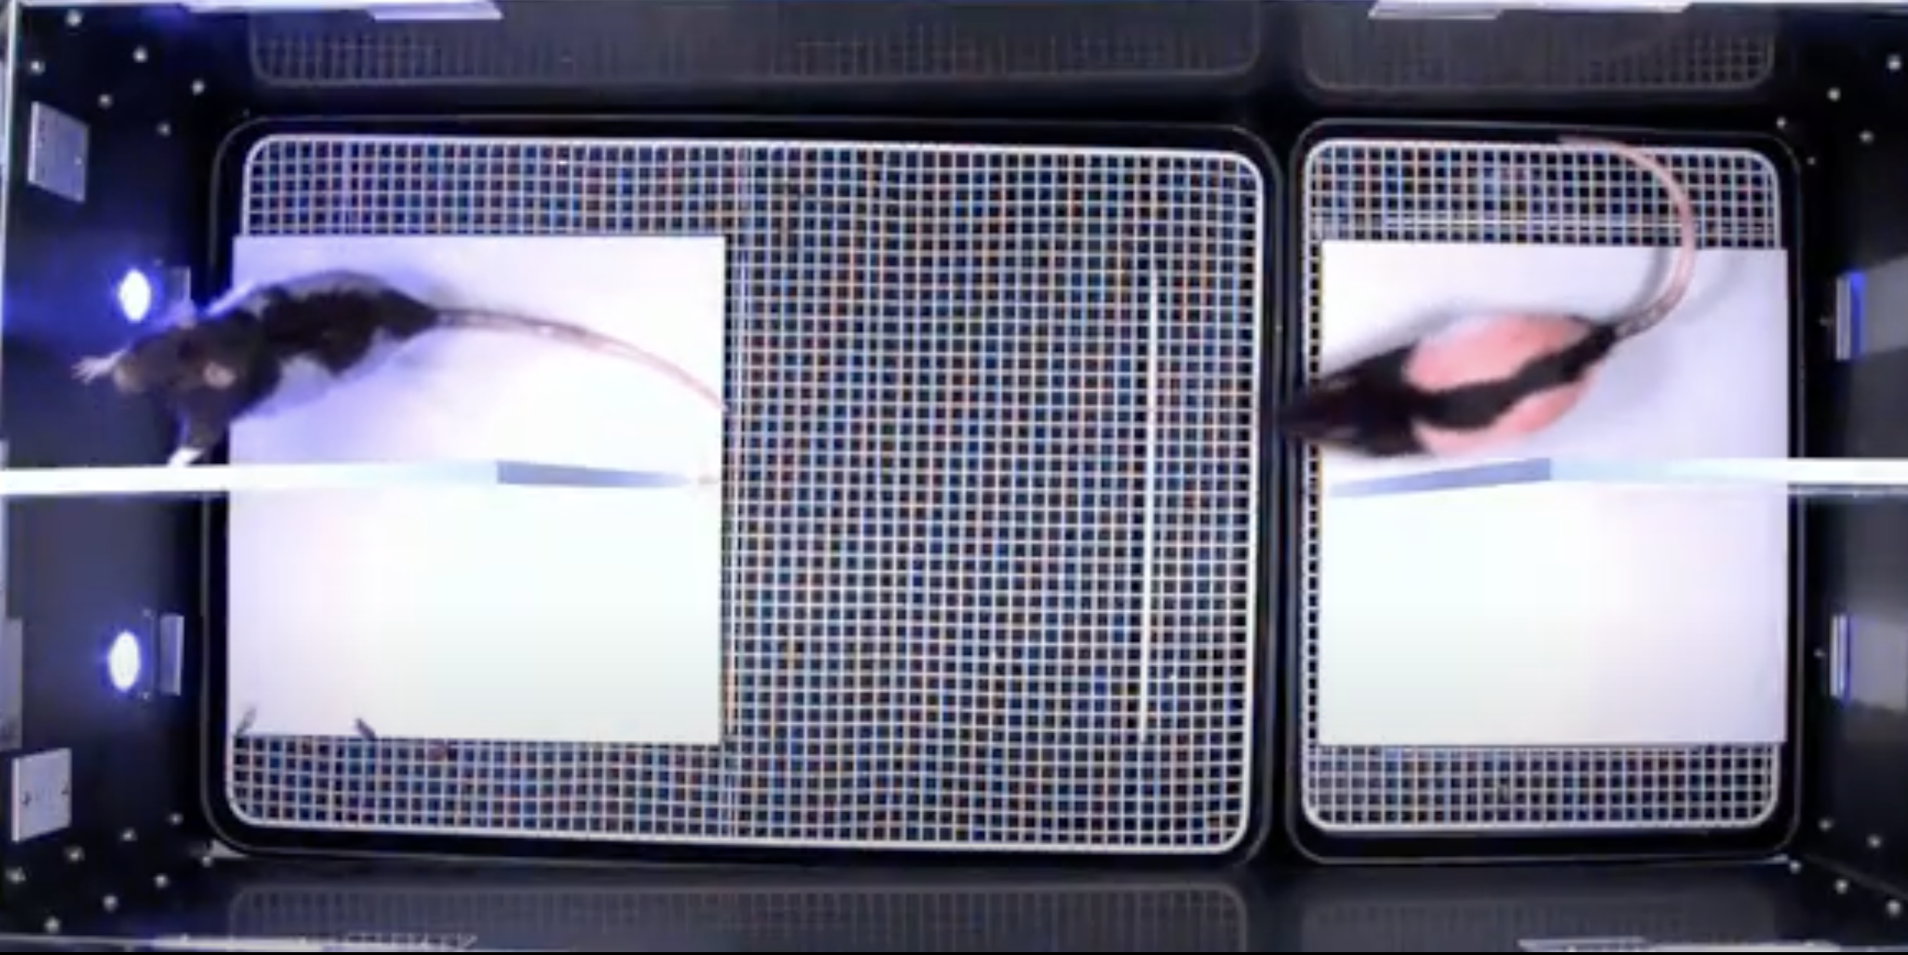
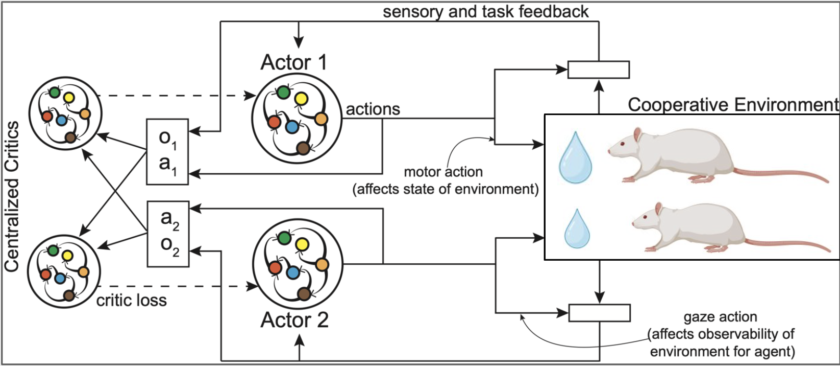
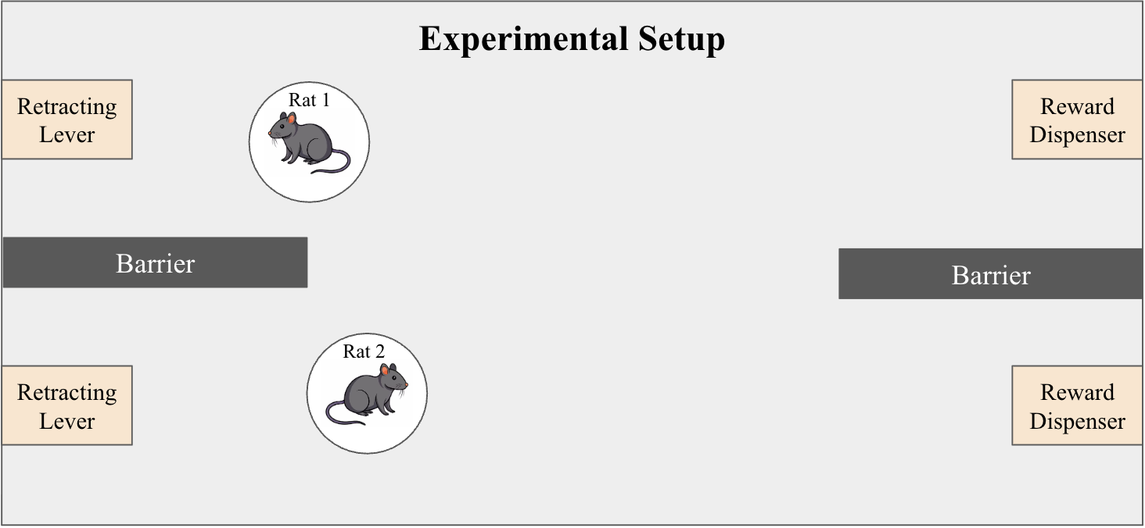
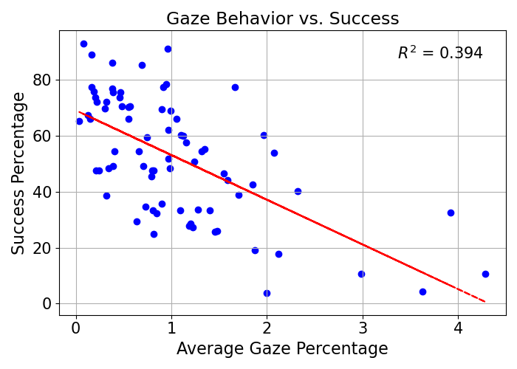
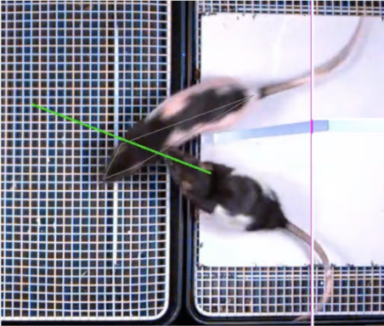
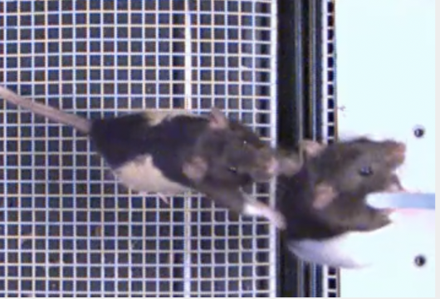
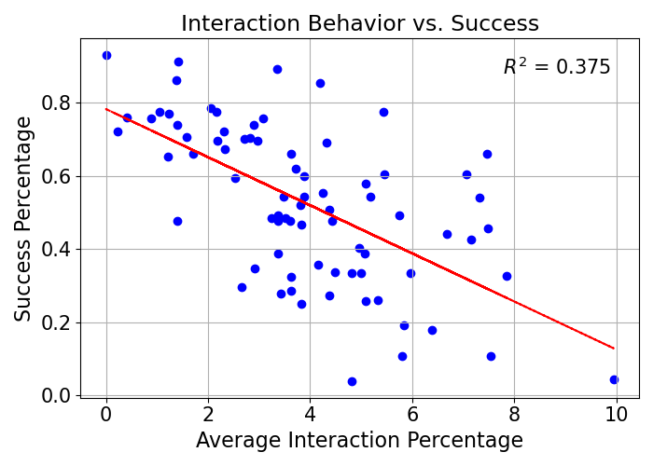
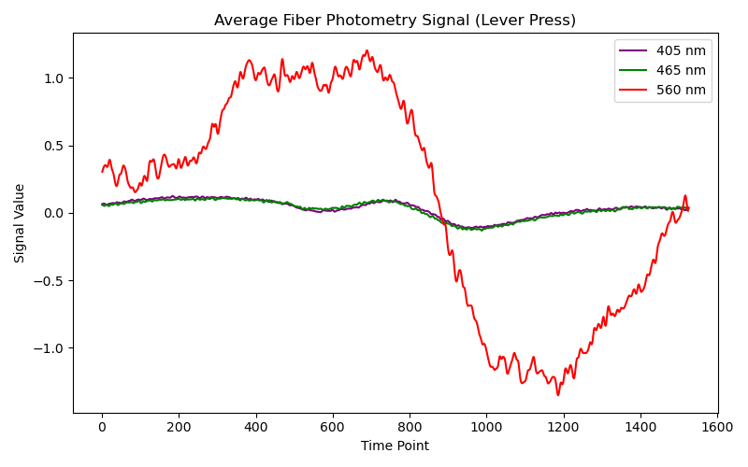
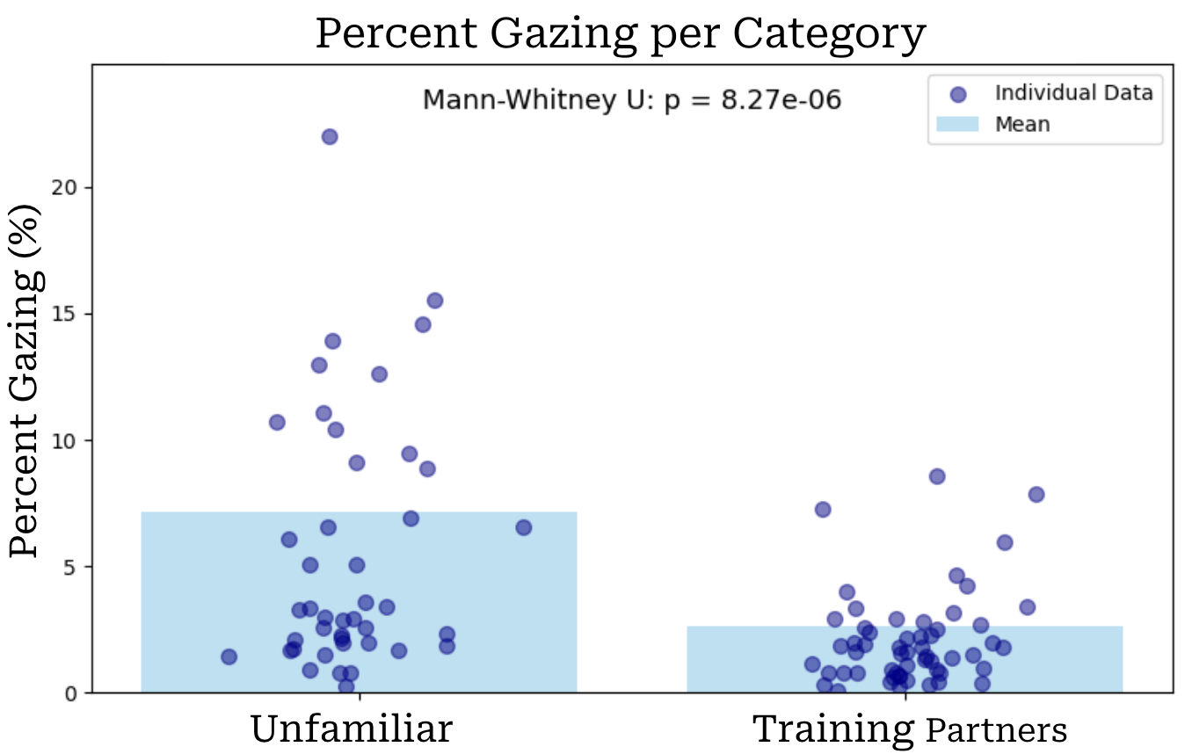
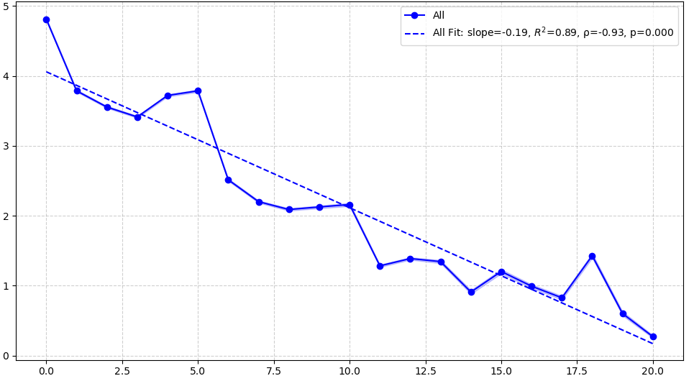
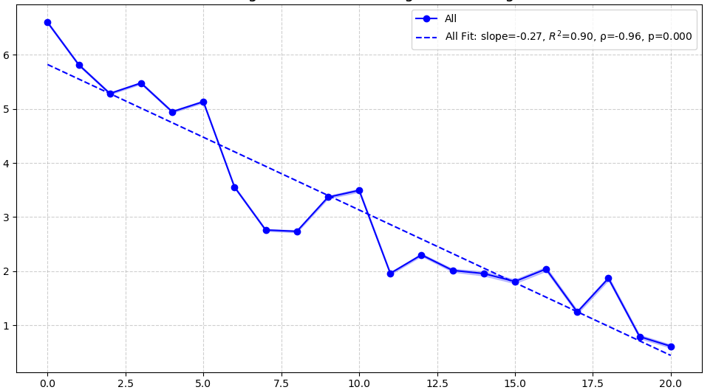
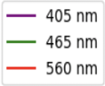

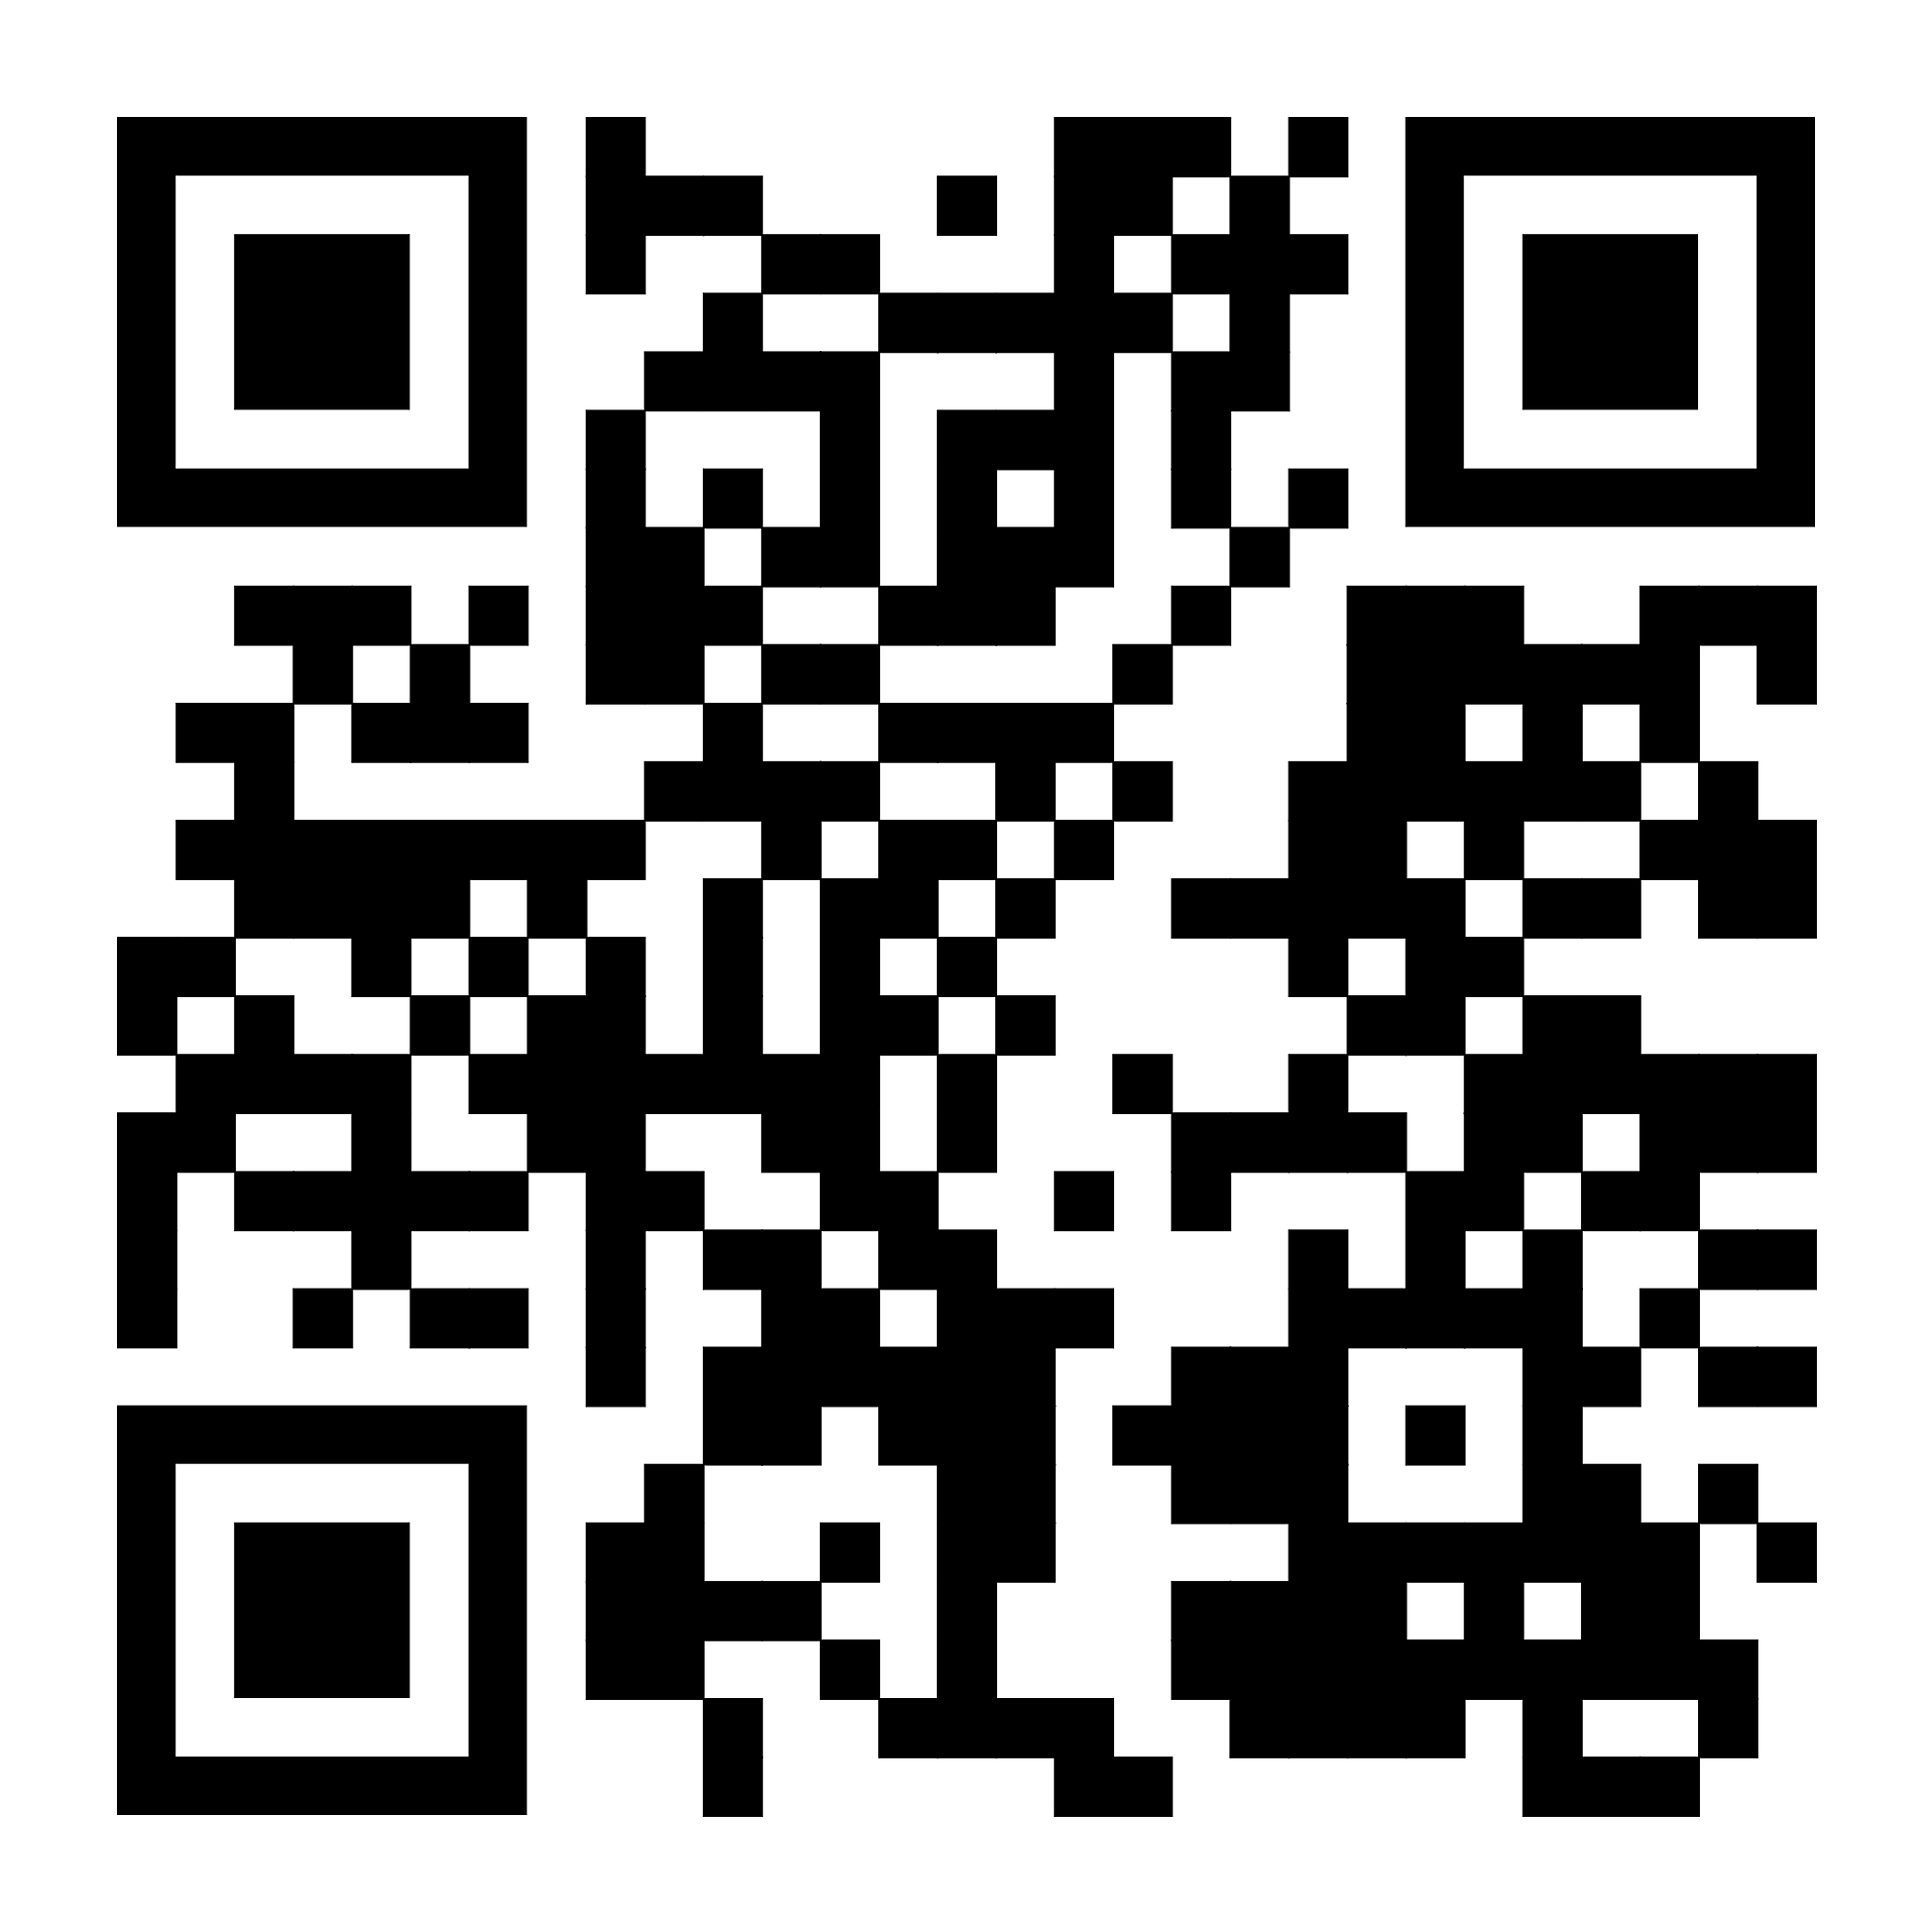

A Computational Framework for Studying Social Cooperation in Rats
David Backer Peral Wu Tsai Institute, Yale University
Introduction
Cooperative Strategies
Behavioral Conclusions
Understanding the neural mechanisms that drive social cooperation is crucial for advancing our knowledge of social behavior and developing treatments for conditions such as autism spectrum disorder and early-life stress. Animals models such as rats can be used to investigate these mechanisms [1], though their behavioral variability makes analysis inherently challenging. While reinforcement learning (RL) has emerged as a promising framework for modeling animal behavior, multi-agent RL algorithms have not yet been applied to the study of social cooperation.
In order to test the validity of RL, we used experimental data of a freely behaving cooperative task in rats from Jane Taylor’s Lab to attempt to analyze the extent to which the models capture animal behavior.
Synchronization
Waiting Before Cue
Waiting Before Press
Rats exhibit different overarching cooperative strategies such as synchronizing their movement, waiting near the levers before the cue, and waiting to press the lever if their partner is far away, demonstrating an awareness of their partners position.
These strategies are not mutually exclusive. In fact, waiting might act as a mechanism to synchronize.
Over training rats learn that waiting near the levers is the most effective strategy to succeed.
Contrary to the initial hypothesis, social behaviors such as gazing and physical interaction in familiar rats seem to serve as distractions rather than a way of communicating.
However, those social behaviors do seem to be a tool for rats to familiarize themselves with their partners, initially.
FIGURE 2. Rats appear to be more synchronized in successful trials.
FIGURE 3. Strong correlation between waiting near the levers before they
come out and cooperative success rate.
FIGURE 4. The further away a rat’s partner is from the lever, the longer they take to press it.
Methods
Modeling Approach
Training:
Pavlovian Conditioning – Associate sound queue with reward
Instrumental Training – Associate lever press at sound queue with reward
Sessions:
Two rats in a cage with two levers on the left side and two reward dispensers on the right side with barriers in between
Rats achieve cooperative success and are rewarded with pellets if levers pressed within 1 second of each other
Experimental Modifications:
Training Partners – pairs of rats that have trained together
Unfamiliar – pairs of rats that have been trained but have not seen current partner
Synchronization
Waiting at Levers
To effectively capture the cooperative dynamics of the task, we use the multi-agent deep deterministic policy gradient (MADDPG) algorithm [3].
FIGURE 5. Number of Rats near Lever at Cue is strong indicator of success. However, synchronization is also an indicator of success independently.
FIGURE 6. As rats train together more, they learn to go to lever before cue more often. Similarly, synchronization increases over sessions.
Waiting Before Press
Success Rate by Number of Rats at Lever at Cue
How Behaviors Influence Success
Moving forward, we can compare the behaviors of strategies of the model with that of the experimental data and assess the extent to which the model captures the real results.
This will allow is to …
Gain an insight into the neural computations underlying the behaviors and strategies required for social cooperation.
Test the validity of RL models in studying social paradigms.
Validating these models through behavioral and neural comparisons will enable more efficient analysis of future perturbations of the task.
Gazing
Physical Interaction
FIGURE 7. Percent of frames gazed is negatively correlated with cooperative success rate across sessions.
Gazing defined as head base, nose vector intersecting other rat for 1/3+ seconds
Interacting defined as close proximity for 1/3+ seconds
FIGURE 8. Percent of frames physically interacted is negatively correlated with cooperative success rate across sessions.
Effects of Familiarity
References
Fiber Photometry
Average Gazing Throughout Training
Average Interacting Throughout Training
Average Fiber Signal Around Lever Press
Fiber photometry data was collected in the Anterior Cingulate Cortex (ACC), specifically in the pathways to the Basolateral Amygdala (BLA) and Anterior Insulate Cortex (AIC); these brain regions have previously been found to be associated with cooperation [2].
Control (405 nm)
ACC → BLA (465 nm)
ACC → AIC (560 nm)
[1] Jiang, M., Wang, M., Shi, Q., et al. (2021). Evolution and neural representation of mammalian cooperative behavior. Cell Reports, 37(11), 110096.
[2] Allsop, S. A., Wichmann, R., Mills, F., et al. (2018). Corticoamygdala transfer of socially derived information gates observational learning. Cell, 173(6), 1329–1342.e18.
[3] Lowe, R., Wu, Y., Tamar, A., Harb, J., Abbeel, P., & Mordatch, I. (2017). Multi-agent actor-critic for mixed cooperative-competitive environments. arXiv:1706.02275
Lever Press
Percent Gazing
Percent Interacting
Signal
Thank you to the Wu Tsai Fellowship, Shreya Saxena’s Lab, Jane Taylor’s Lab, and Amelia Johnson for all their help and guidance.
Figure 9. Unfamiliar rat pairs exhibit significantly lower gazing percentages than rat pairs who are training partners.`
Experiment Index
Experiment Index
Time Point
Figure 10. Gazing decreases throughout training.
Figure 11. Physical interactions decrease throughout training.
FIGURE 1. Neural Signals before and after lever press
*Experimental Index represents how many times the rat pairs have seen each other
Link to examples and code.
david.backerperal@yale.edu

